Slide 1

Girder
Data management for the web

Slide 2
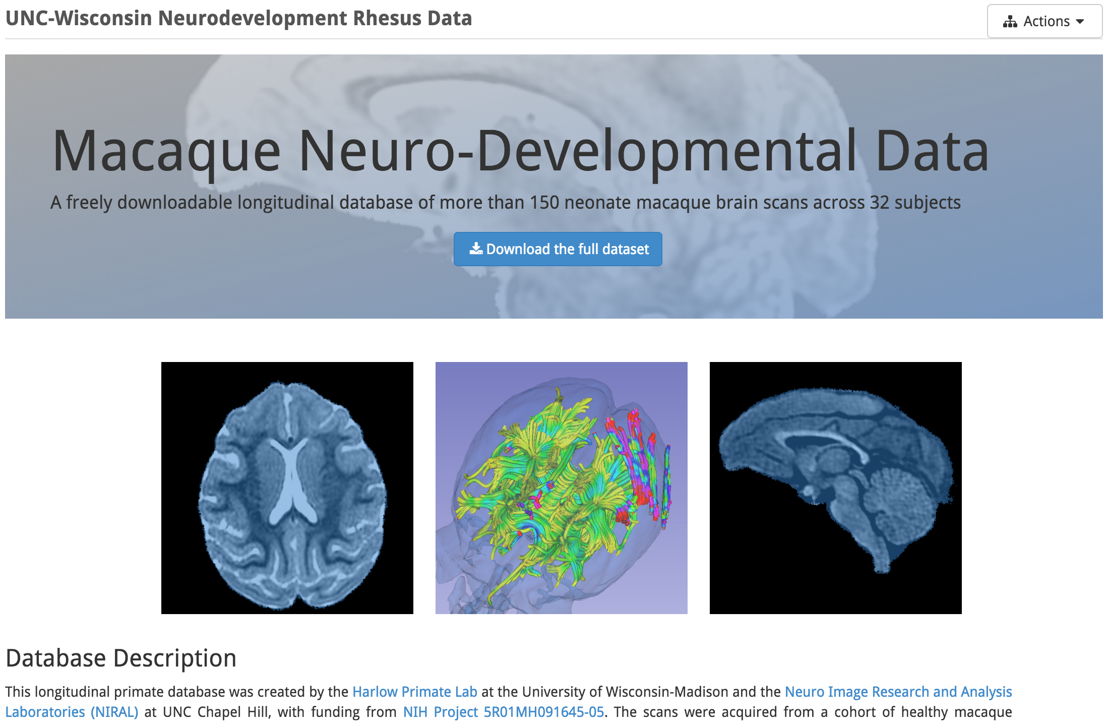
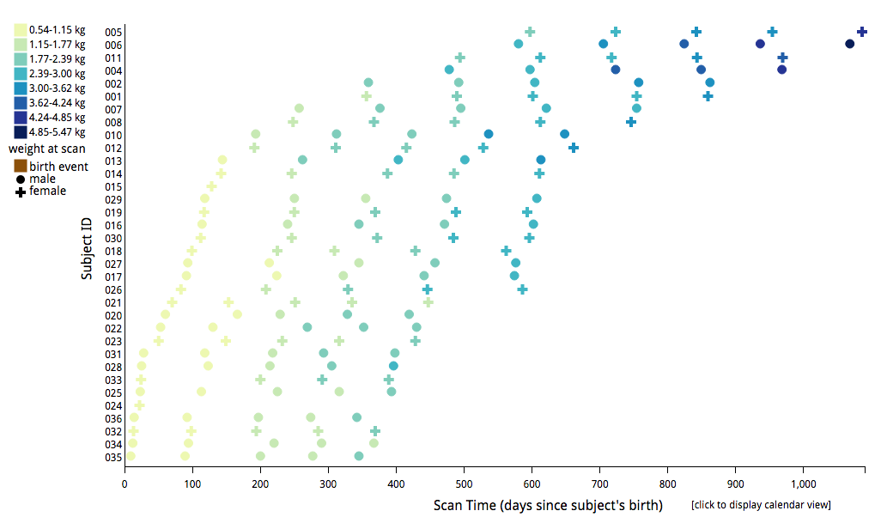
High Level Goals
Scientific reproducibility
Organization and discovery of data
Girder

Slide 3
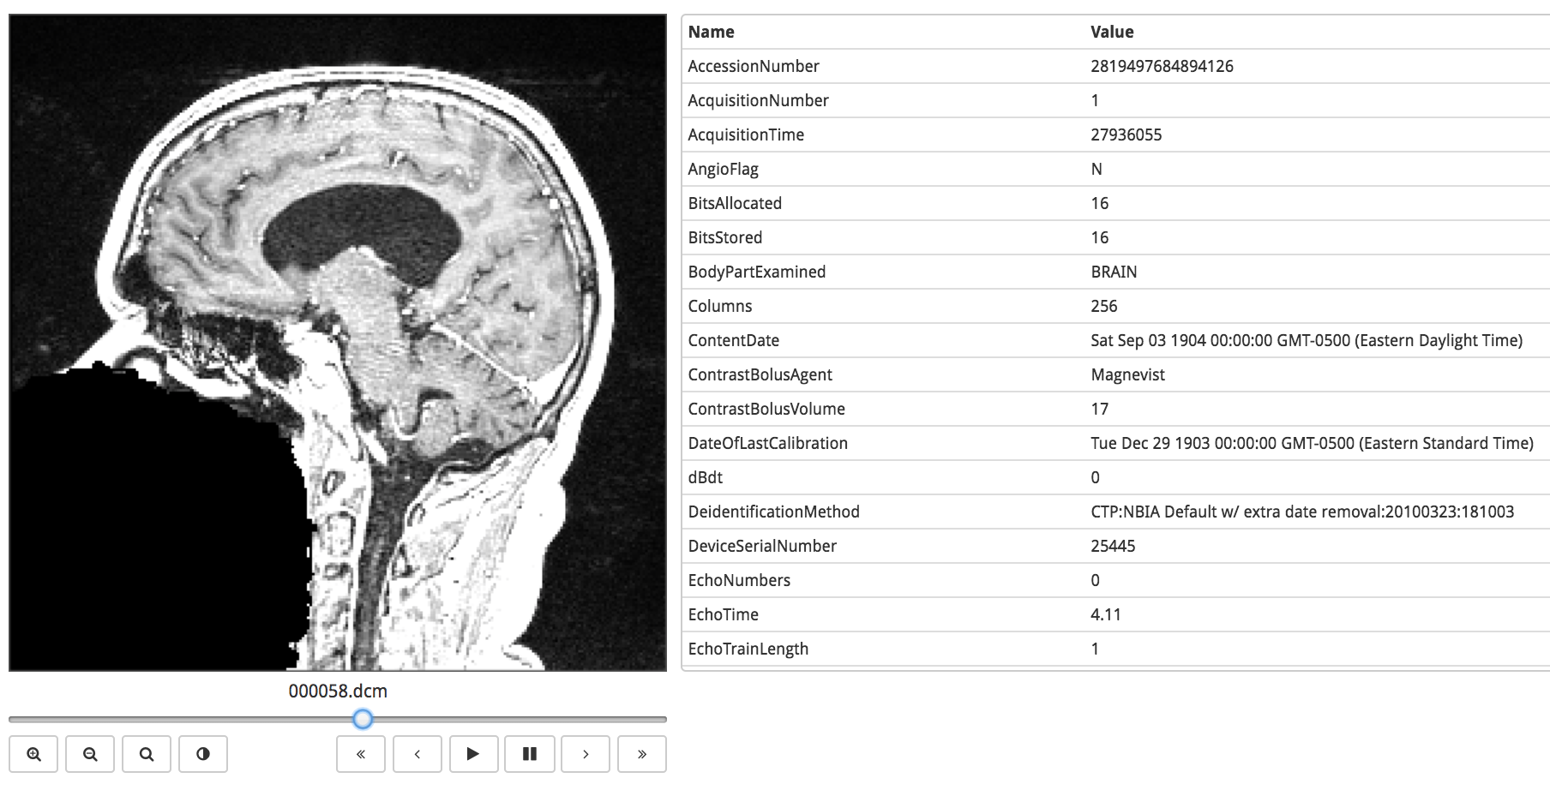
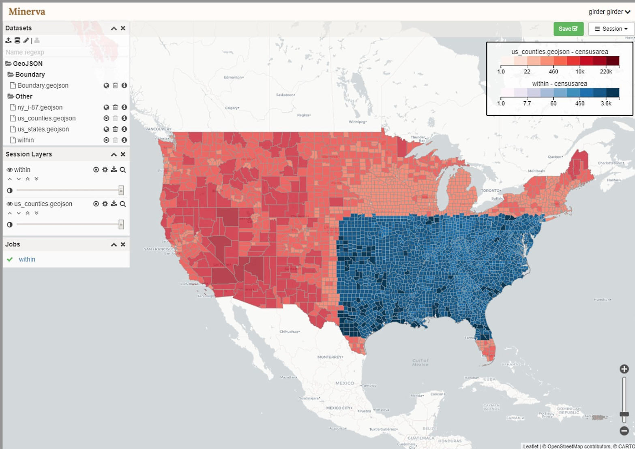
What do we mean by data management?
Storage, access, and sharing of files and metadata
Browsing/viewing/sharing behind a single abstraction
Girder

Slide 4

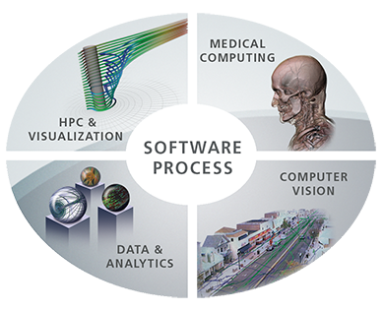




Design choices and rationale
(Kitware is a collaborative, open source consultancy)
Focus on flexibility and extensibility
Integration of visualization and analytics
Girder

Slide 5
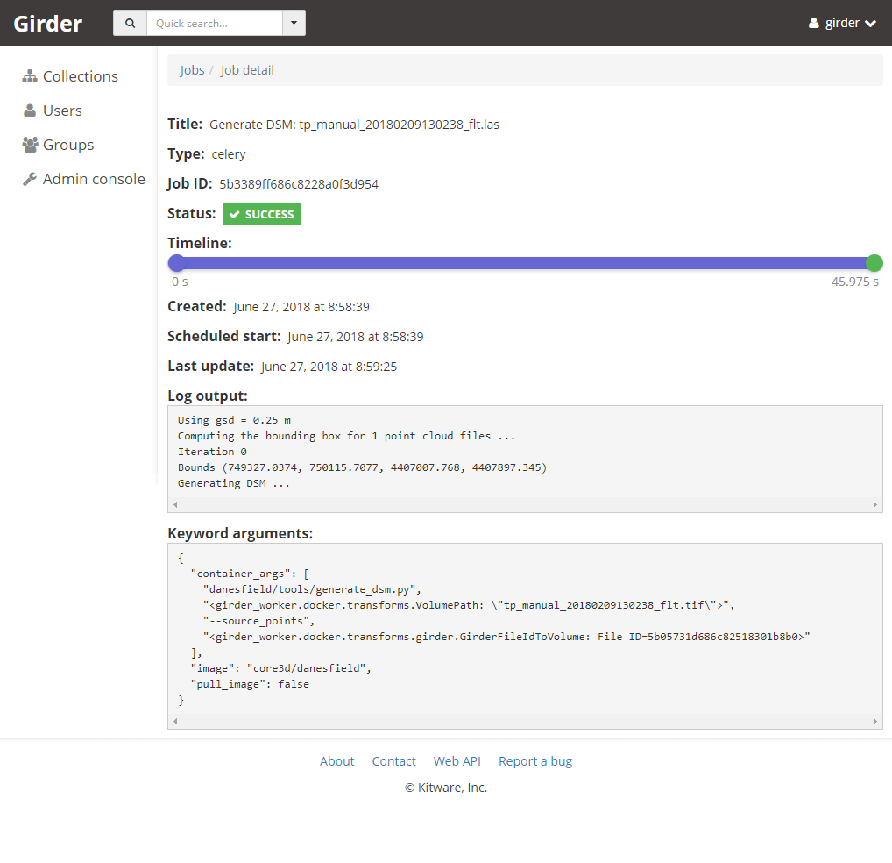
What value does Girder provide?
Data indexing: browse/search/filter
Data provenance: track data through transformations
Data abstraction: expose data in a (more) uniform way
Girder

Slide 6
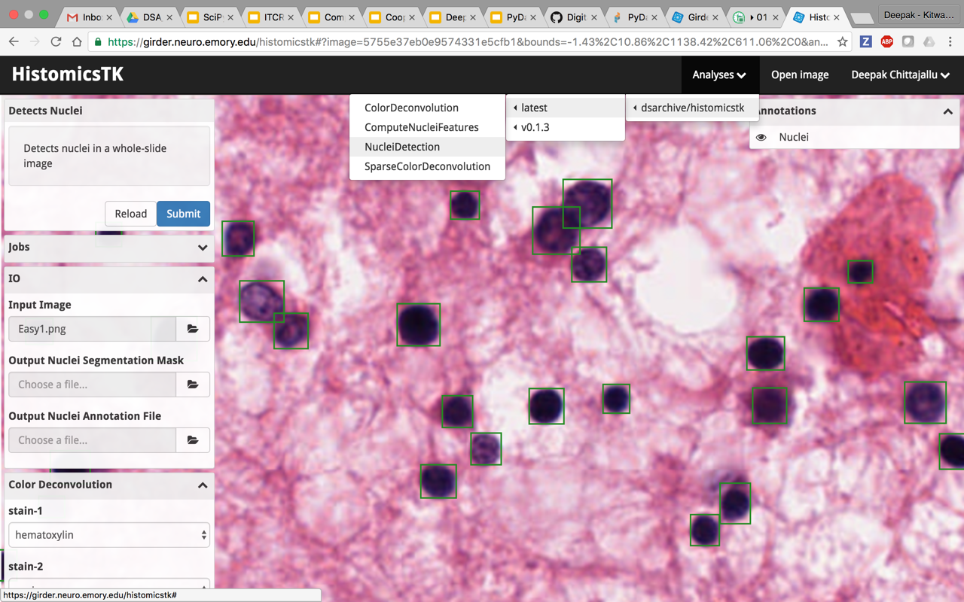
Used across multiple domains
Software quality
Medical imaging
Histopathology
Geospatial
Chemistry
Computer Vision
Neuroscience
Girder

Slide 7

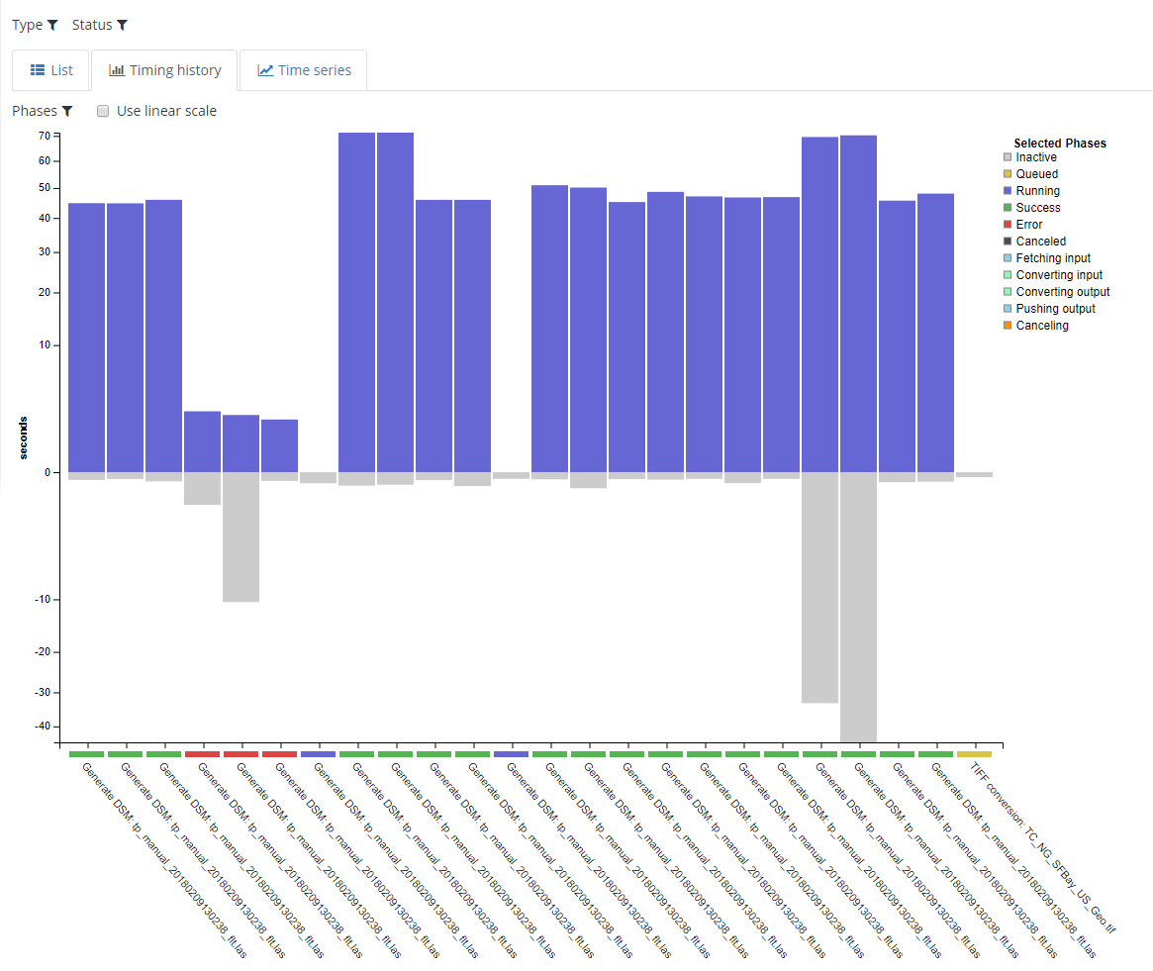
Analytics through Girder Worker
(Thin wrapper integrating Celery)
Shipping and handling of data, metadata, args, outputs
Remote execution in Python or Docker
Status updates and tracking
Girder

Slide 8
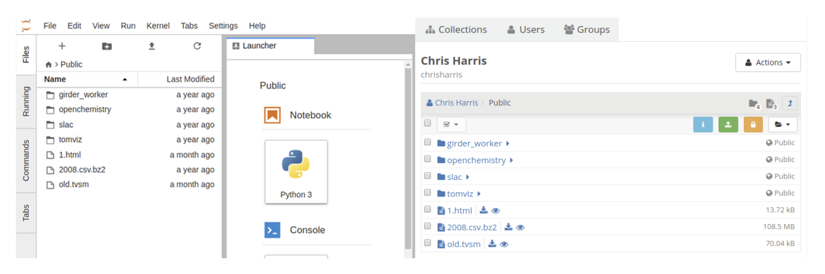
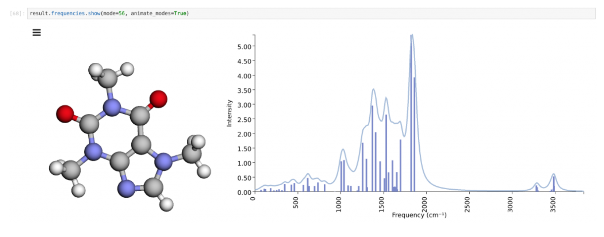
Near Term Roadmap
Deeper integration with JupyterLab
Improved metadata querying
Cohort construction to feed analytics
Better provenance and workflow artifact tracking
Girder

Slide 9
Further Roadmap
(Onward and Upward!)
Enabling infrastructure for software centered science
Research algorithm development
Software quality
Interactive browsing of complex datasets
Client + Server visualization
Analytic processing close to the data
Girder

Slide 10
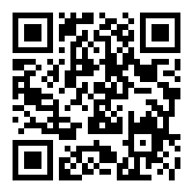
References
Docs http://girder.readthedocs.io/en/latest/
Code https://github.com/girder/girder
Discourse https://discourse.girder.org/
Girder, part of the Resonant platform
Slides: bit.ly/scipy2018-girder-talk
Girder

